Slide 1
Machine Learning
Unit – 2 – [Part 2]
Parametric Methods

Slide 2
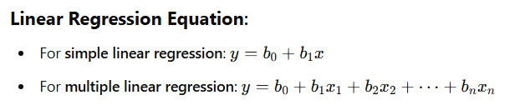
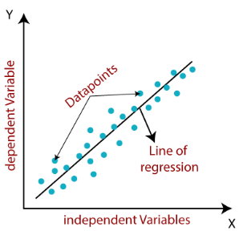
Parametric Methods
Parametric methods use a fixed structure or a fixed number of parameters, and this structure does not change regardless of the size or nature of the data.
For example:
Linear Regression-
No matter the size or type of data, the equation stays the same. It always fits a straight line (for one independent variable) or extends linearly for multiple independent variables. The equation never changes, which is why linear regression is considered parametric. The fixed structure and equation are key characteristics of parametric methods.

Slide 3
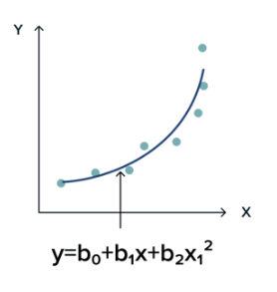
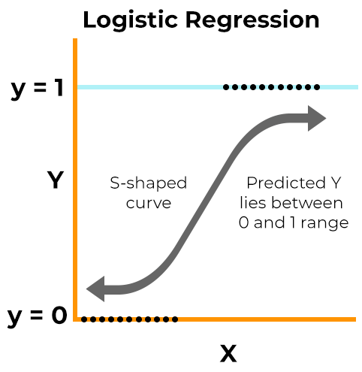
Polynomial Regression-
No matter the size or type of data, the equation in polynomial regression stays the same. It fits a curve defined by the chosen polynomial degree (e.g., quadratic, cubic). The equation never changes, which is why polynomial regression is considered parametric. The fixed structure and equation are key characteristics of parametric methods.
Logistic Regression-
No matter the size or type of data, the equation in logistic regression stays the same. It always fits an S-shaped curve (sigmoid function) to model probabilities. The equation never changes, which is why logistic regression is considered parametric. The fixed structure and equation are key characteristics of parametric methods.

Slide 4
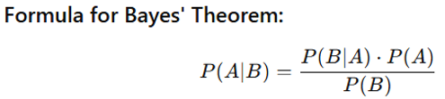
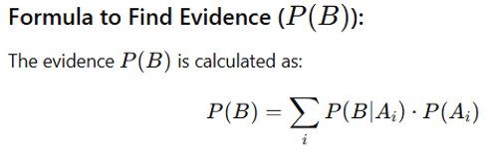
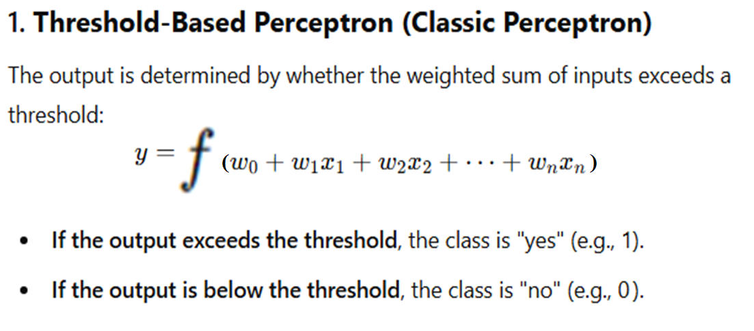
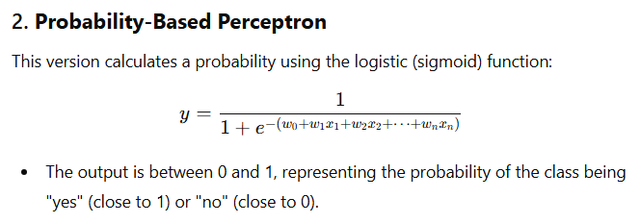
Naive Bayes:
No matter the size of the data, Naive Bayes always uses a fixed formula to calculate posterior probabilities. This fixed structure makes Naive Bayes a parametric method.
Perceptron:-
No matter the size of the data, Perceptron uses a fixed structure with weights and biases to create a linear decision boundary. This fixed structure and parameter set make Perceptron a parametric method. Both types of Perceptron use a fixed equation, making them parametric methods. The difference is that one uses a threshold for classification, while the other gives a probability.

Slide 5
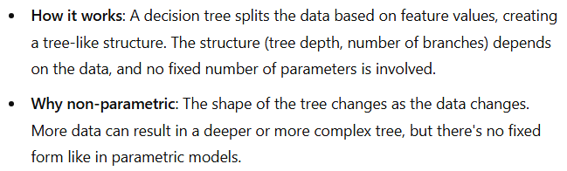
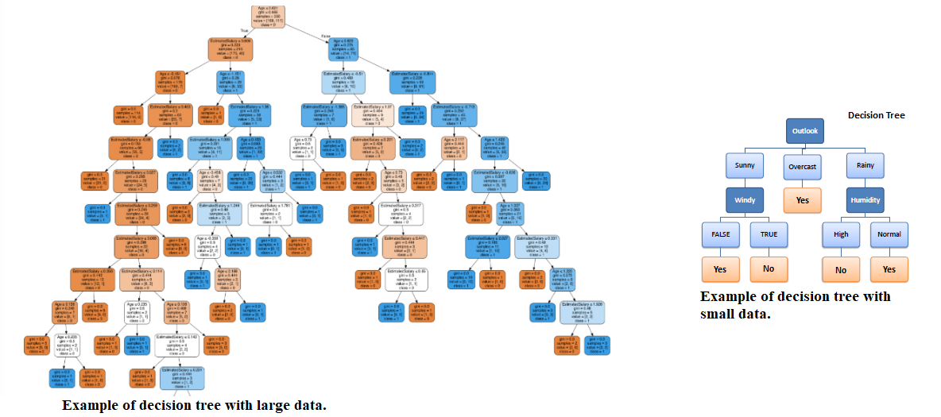
Non-Parametric Methods
Non-parametric methods are different from parametric methods because they don’t assume any fixed structure or form for the model. Instead, they adapt based on the data itself. They are flexible and can model complex relationships without needing predefined parameters.
For example:
Decision Trees-

Slide 6
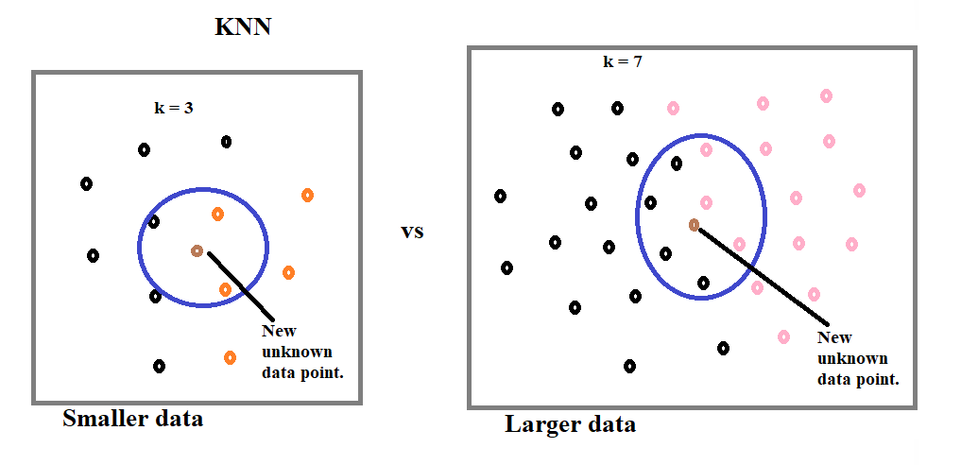
K-Nearest Neighbors (KNN)-
In KNN, the value of k (number of neighbors) can start at 3, but as the data size grows, we usually increase k to capture more details. The complexity of KNN increases with both the size of the data and the value of k. There’s no fixed value for k, and it’s chosen based on the data, often using methods like cross-validation. This flexibility makes KNN a non-parametric method.

Slide 7
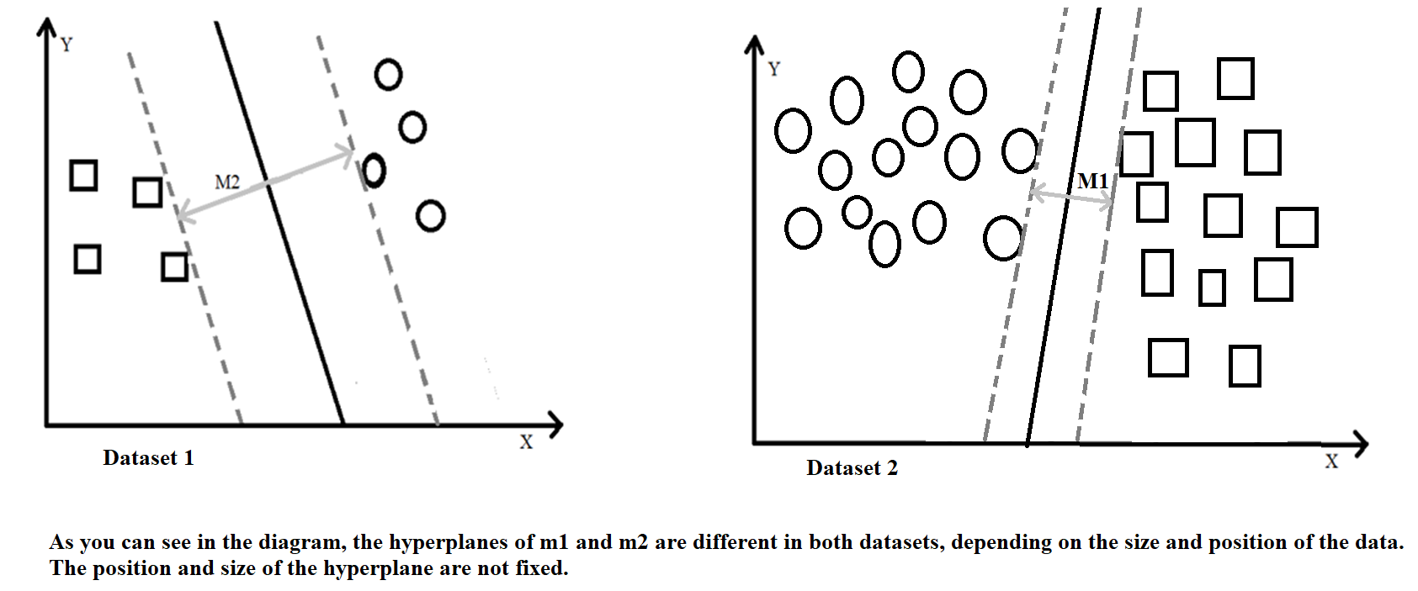
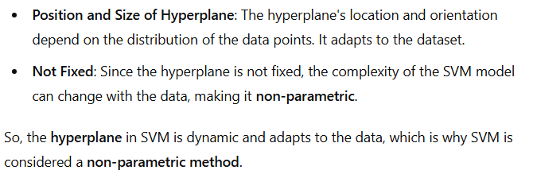
Support Vector Machine-

Slide 8
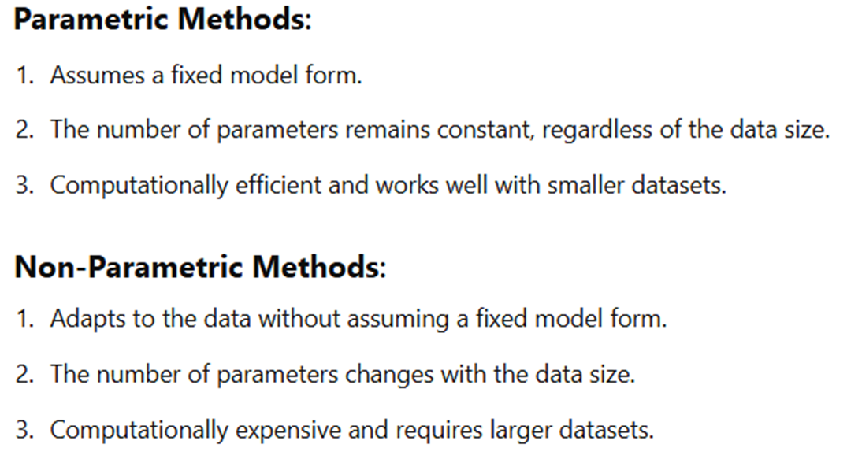

Slide 9
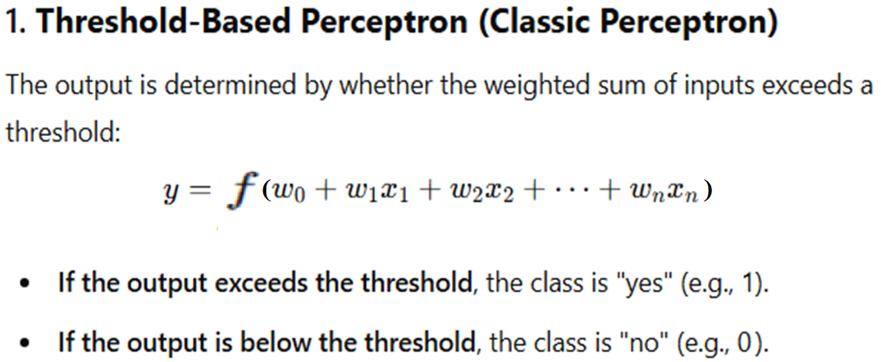
Parametric Classification:-
Linear Regression, Logistic Regression, Naive Bayes, etc., were covered in our previous unit. In this unit, we are focusing on another parametric classification method: Perceptron.
Perceptron-

Slide 10
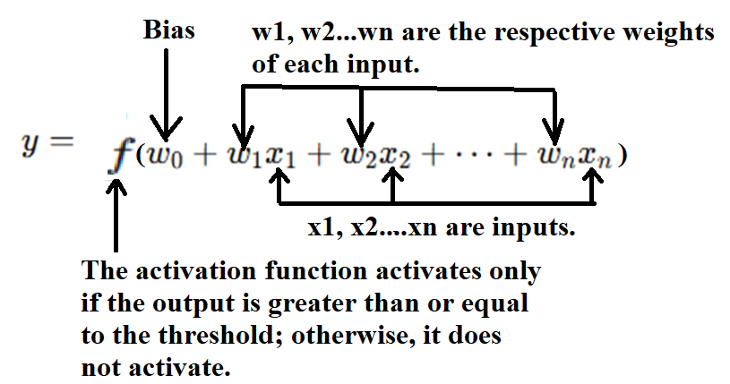

Slide 11
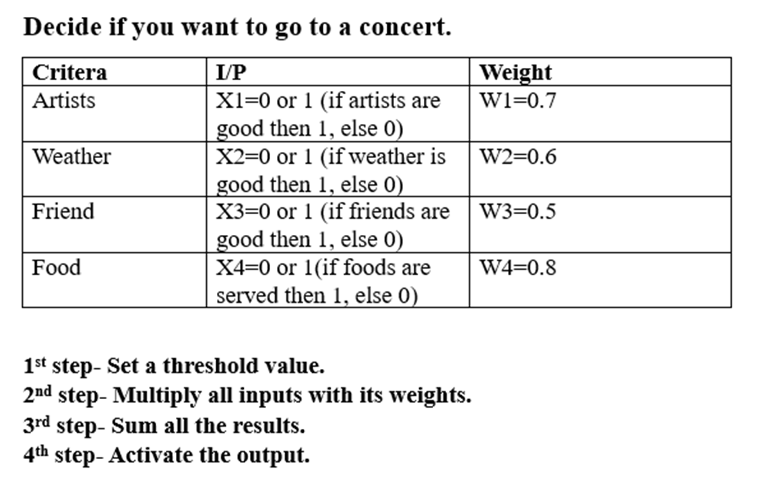

Slide 12
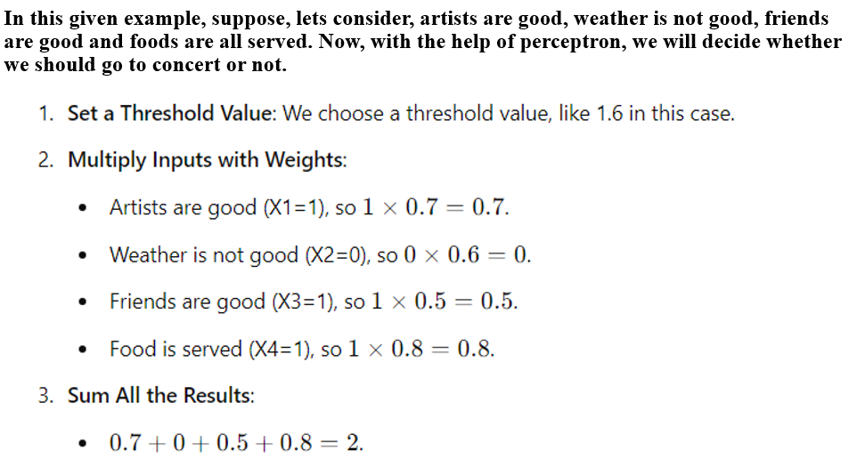

Slide 13
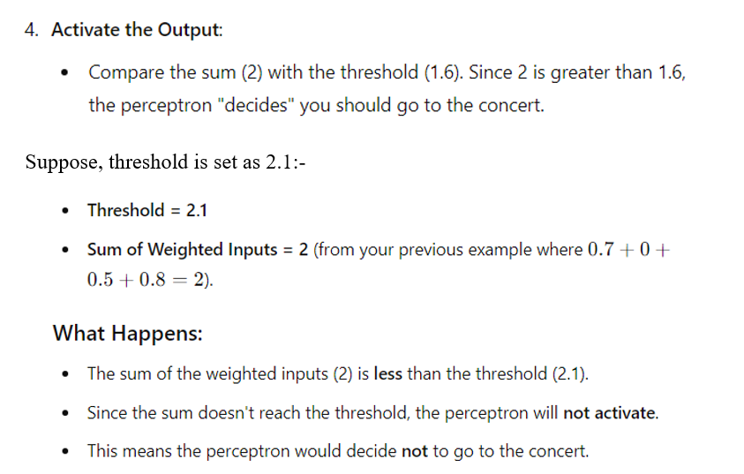

Slide 14
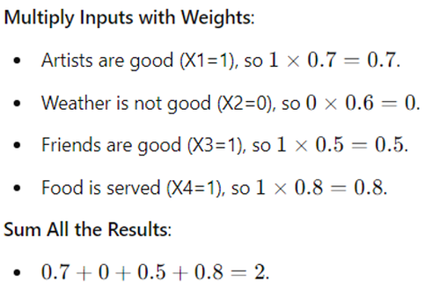
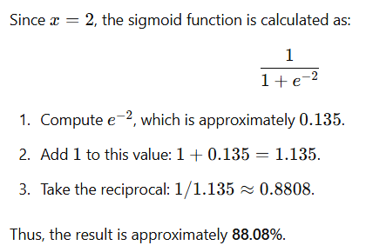
Suppose, we don’t have a threshold and instead we want to calculate the probability, we can apply a sigmoid function to the weighted sum of inputs. The sigmoid function maps any real number to a value between 0 and 1, representing a probability.

Slide 15
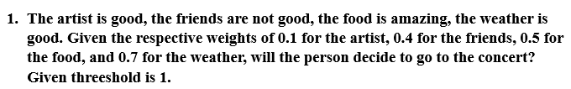
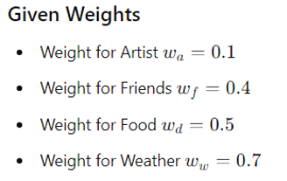
Let’s see numericals:-
Numerical 1:-
Ans:-

Slide 16
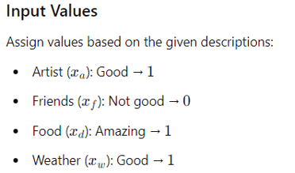
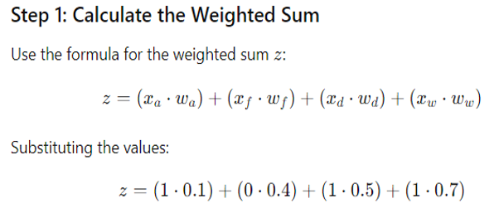

Slide 17
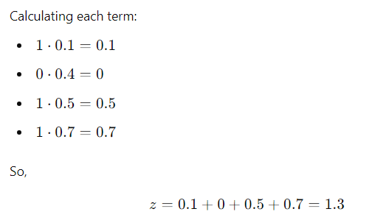
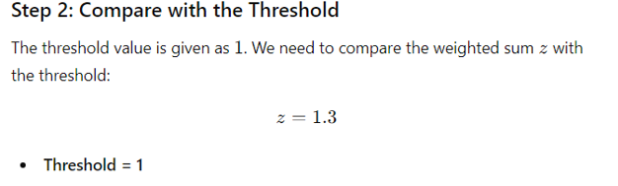

Slide 18
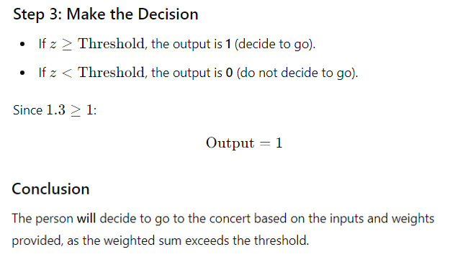

Slide 19
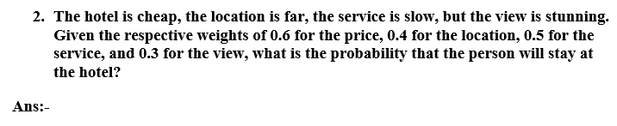
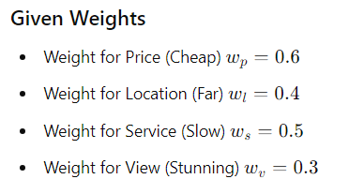
Numerical 2:-

Slide 20
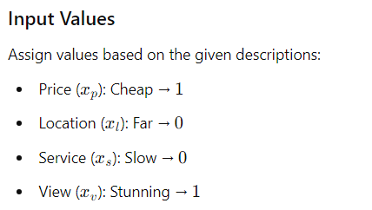
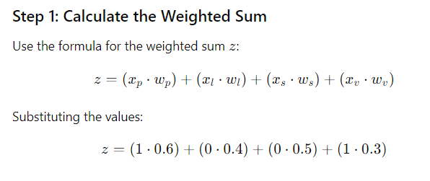

Slide 21
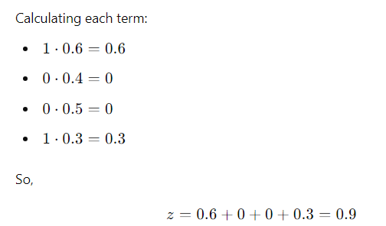
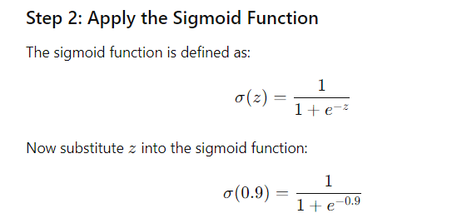

Slide 22
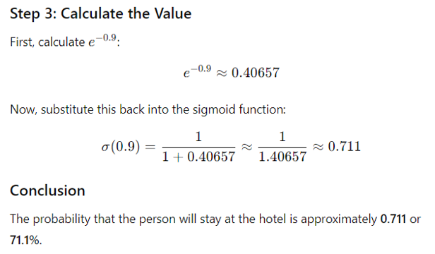

Slide 23
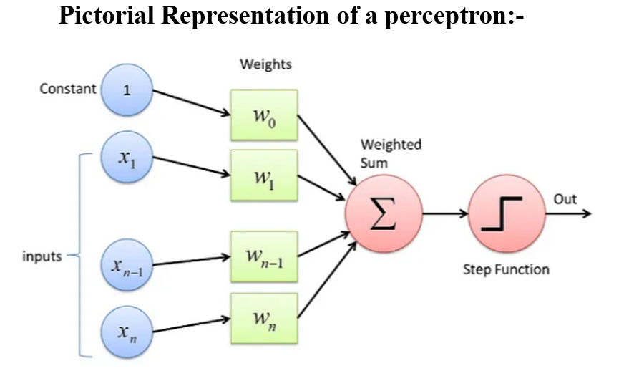

Slide 24
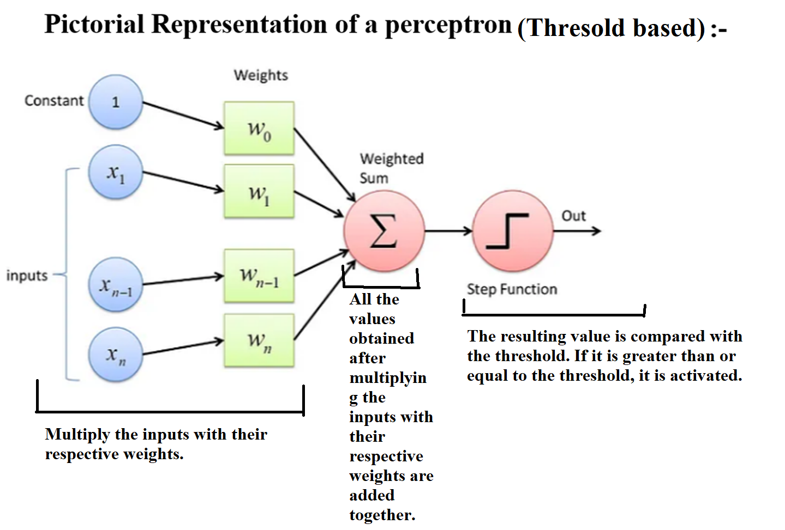

Slide 25
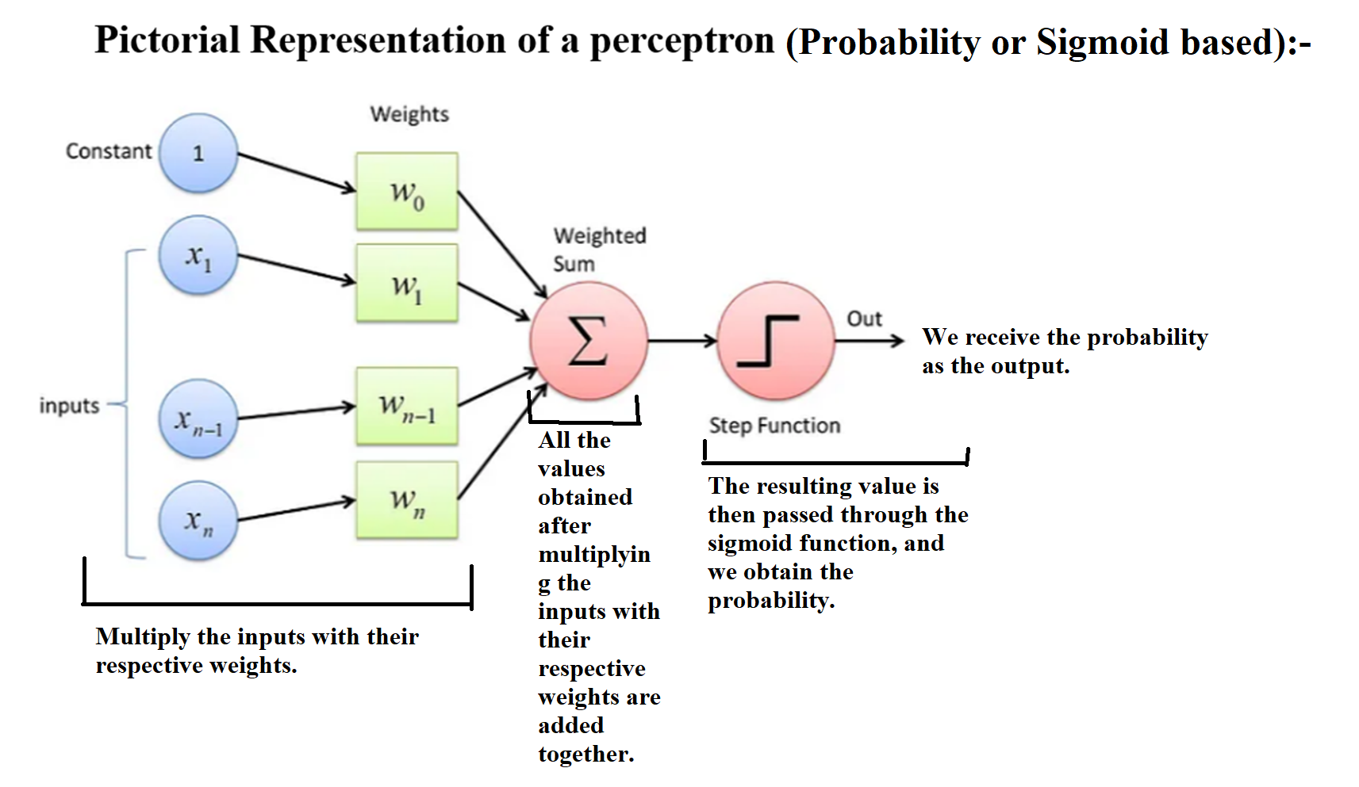

Slide 26
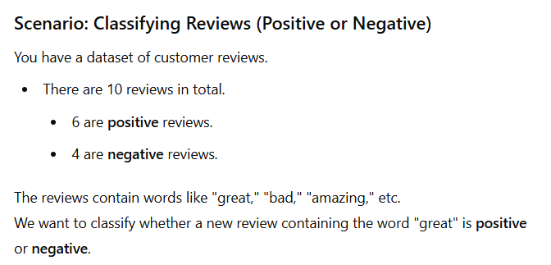
Maximum Likelihood Estimation (MLE)
MLE is the method used to estimate the prior and likelihood probabilities, which Naive Bayes plugs into Bayes' Theorem to calculate the posterior probability. So far, we have seen how to use likelihood and prior probabilities to calculate the posterior probability. In MLE, we will learn how to calculate the likelihood and prior probabilities.

Slide 27
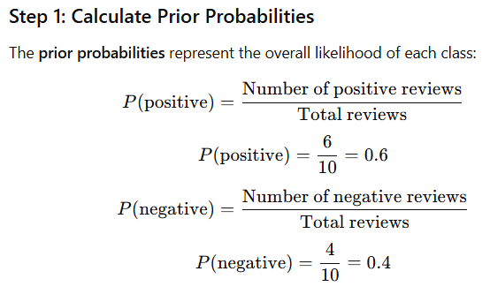
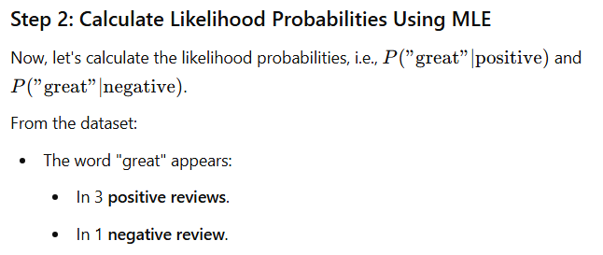

Slide 28
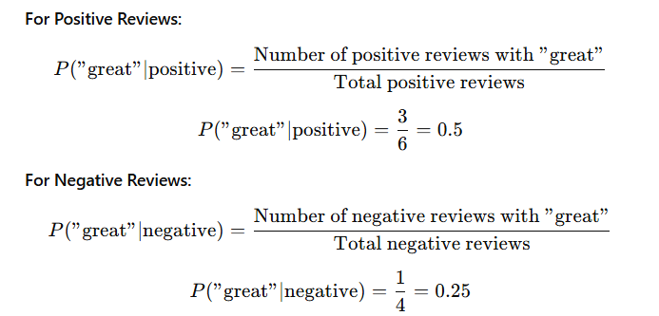
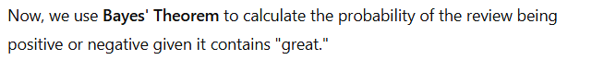

Slide 29
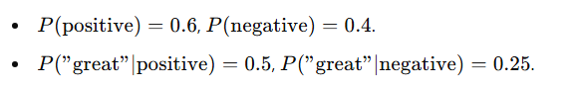
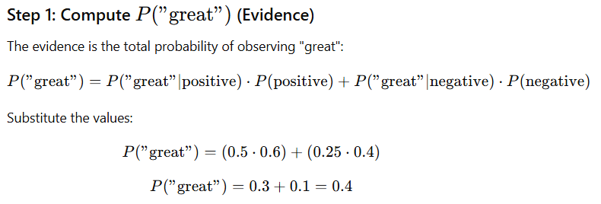

Slide 30
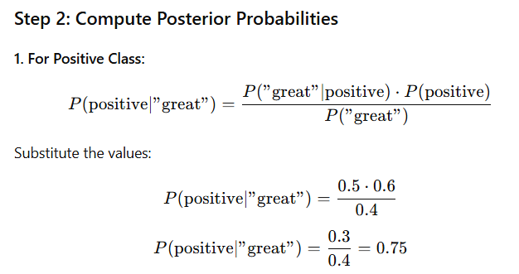
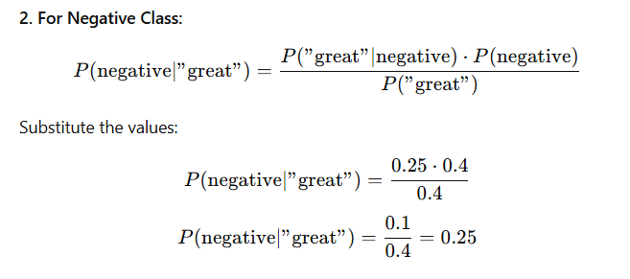

Slide 31
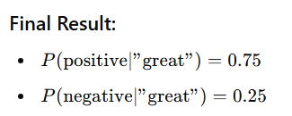
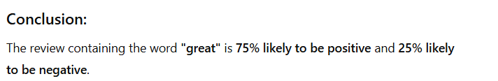

Slide 32
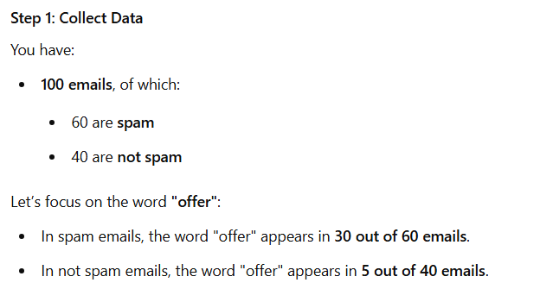

Another numerical:-
You are building a system to classify emails. You have 100 emails, of which, 60 are spam and 40 are not spam. Let’s focus on the word "offer“. In spam emails, the word "offer" appears in 30 out of 60 emails. In not spam emails, the word "offer" appears in 5 out of 40 emails. Estimate Probabilities Using MLE and find posterior probabilities.

Slide 33



Slide 34

Successfully obtained prior and likelihood probabilities using Maximum Likelihood Estimation (MLE).

Slide 35




Slide 36



Slide 37



Slide 38


Slide 39


Bias and Variance

Slide 40



Slide 41



Slide 42



Slide 43



Slide 44


Bias and variance are used to determine whether the model is underfitting or overfitting. The bias-variance trade-off highlights the need to find a balance between these two factors for better model performance. To achieve this, we can use techniques such as cross-validation, regularization, etc.

Slide 45




Slide 46



Slide 47



Slide 48



Slide 49


Slide 50



Slide 51


The Bayes’ Estimator

Slide 52


Example 1:-

Slide 53




Slide 54

Example 2:-

Slide 55



Slide 56




Slide 57


Example 3:-

Slide 58




Slide 59


Slide 60



Parameter Estimation

